Slide 1

Infrastructure as Code: What Is It, and Why Should You Care? Ahmad Obay – Senior Systems Engineer
April 2020

Slide 2
Agenda
1
Introduction
2
What is Infrastructure as Code?
3
Why is IaC important?
4
How can you leverage IaC?
5
Demo of IaC in action
6
Conclusion

Slide 3

Introduction
Who I am?
Who is this presentation for?
What will we be talking about?
Infrastructure As Code

Slide 4
What is Infrastructure as Code (IaC)?
Code
Infrastructure

Slide 5
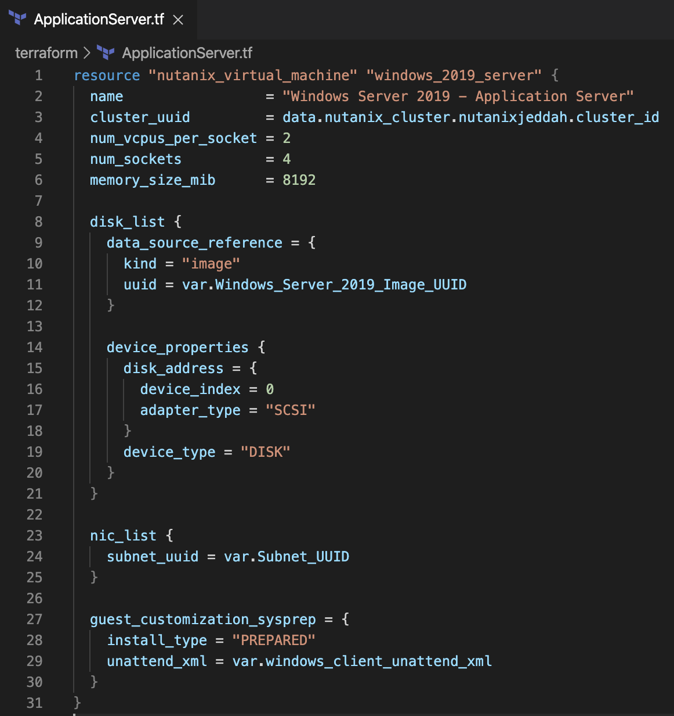

What is Infrastructure as Code (IaC)?
Code
Infrastructure

Slide 6

Why is IaC Important?

Slide 7
Documentation
Document your infrastructure so you are on-top of what is running in your infrastructure.

Slide 8
Auto-Healing
Continuously converges (correct) your infrastructure to match what is documented so your infrastructure is always self-healing and not drifting away from the documentation.

Slide 9
Automation
Automates the process of creating new infrastructure and cut the time needed to rebuild your entire infrastructure to minutes instead of months in-case of major incident.

Slide 10
Consistency
Code will always provide consistent, identical results while point-and-click results will usually differ.

Slide 11
Eliminate Human Error
Taking point-and-click out of the picture and saving the massive cost in time and money associated with human error.

Slide 12
Stop Brain-Drain
Avoid lost knowledge when employees leave the company by capturing your team knowledge in the code.

Slide 13
Reusability
Once you invest in documenting a certain part of your infrastructure, you can use it multiple times while maintaining the same level of standards and procedures.

Slide 14
Collaboration
Collaborate on the same code with others without sharing access to your infrastructure.

Slide 15
Versioning
You can version your infrastructure the same way developer’s version their code. Which means you will always know who changed what when why.

Slide 16
Testing
You can test the code before deploying it which saves time and effort during deployment.

Slide 17

Stay Future Proof
“by 2024, 70% of new application developed with programming languages will be deployed in containers.”
IDC

Slide 18
What you need to evolve from point-and-click to IaC?

Slide 19
The Right Team Skills (Build or Buy)
DevOps Mentality
Coding skills
IaC tools
Configuration Management tools

Slide 20
The Right Infrastructure
All the public cloud features, in your datacentre.

Slide 21
Just Start!
Land and Expand
Stay Current
Prepare for the Future

Slide 22
Demo of IaC Power

Slide 23
Conclusion
1
IaC will drastically improve your efficiency
2
IaC is probably going to solve many issues you are facing today
3
IaC is not something you buy; you will have to build the know-how and team discipline to use it
4
IaC is not sci-fi, you can start using it today and reap the benefits
5
You need the right IT infrastructure for the job

Slide 24
Thank you

